Slide 1

RISING STAR SPORTS INSTITUTE
WEB-DESIGNING PROJECT
NAME: Ambika Ghosh
ROLL NO. : 12101213
GROUP : CE7

Slide 2



WHAT IS WEB- DESIGNING?
Web Designing is Planning and Creation of Websites. It deals with the process of developing a website. Web Designing ranges from creating plaintext pages to complex web-based applications, social network applications and electronic business applications.
It involves creating the visual and functional elements of websites or web applications. It encompasses various aspects, including layout, color scheme, typography, graphics, images, and interactive features, all aimed at enhancing user experience and achieving the website's objectives.

Slide 3

INTRODUCTION
Project Details:
Title : Rising Star Sports Institute
Type : Sports Institute Website
Technology Used:
Hyper Text Markup Language
Cascading Style Sheet
Java Script

Slide 4
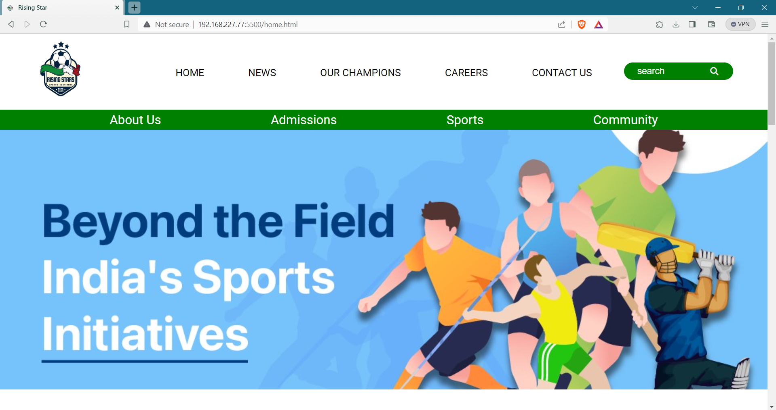
Home page of the Website
Navigation Bar
Poster

Slide 5
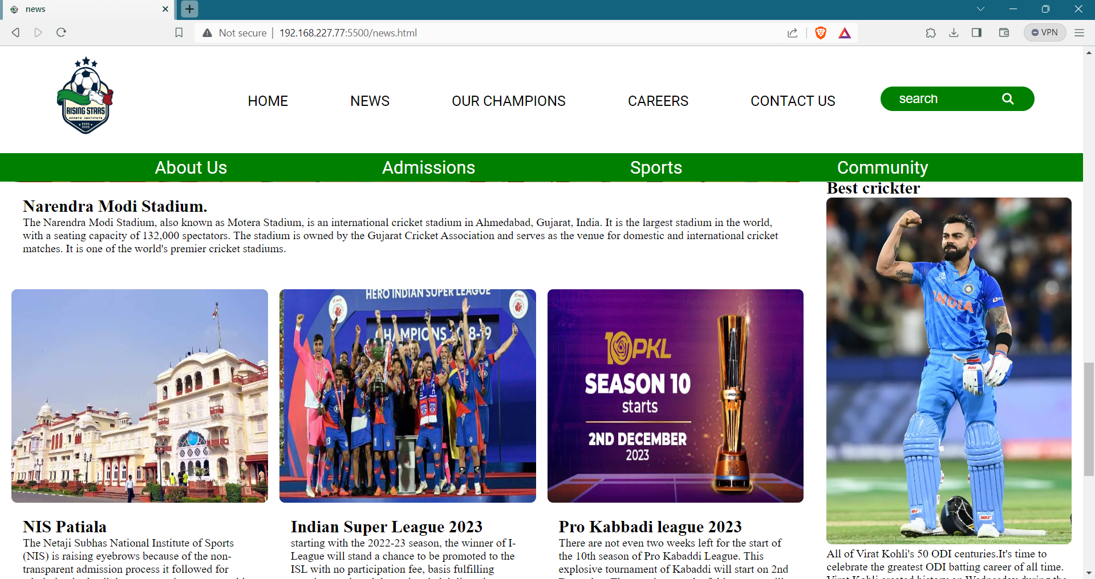
News Page of Website
This Page contain tiles which shows Information and news

Slide 6
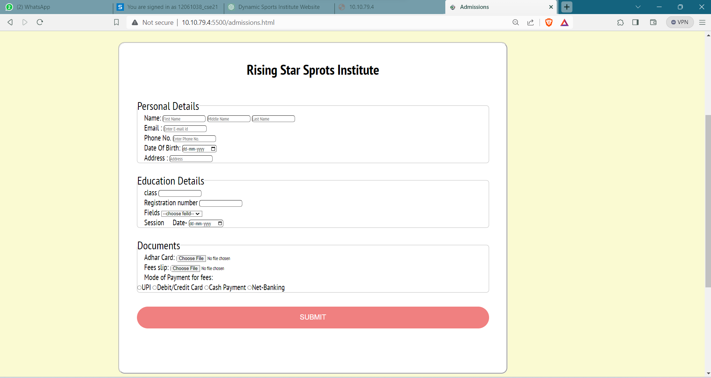
Admission page
Click here to
print the
receipt
Fill the Form

Slide 7
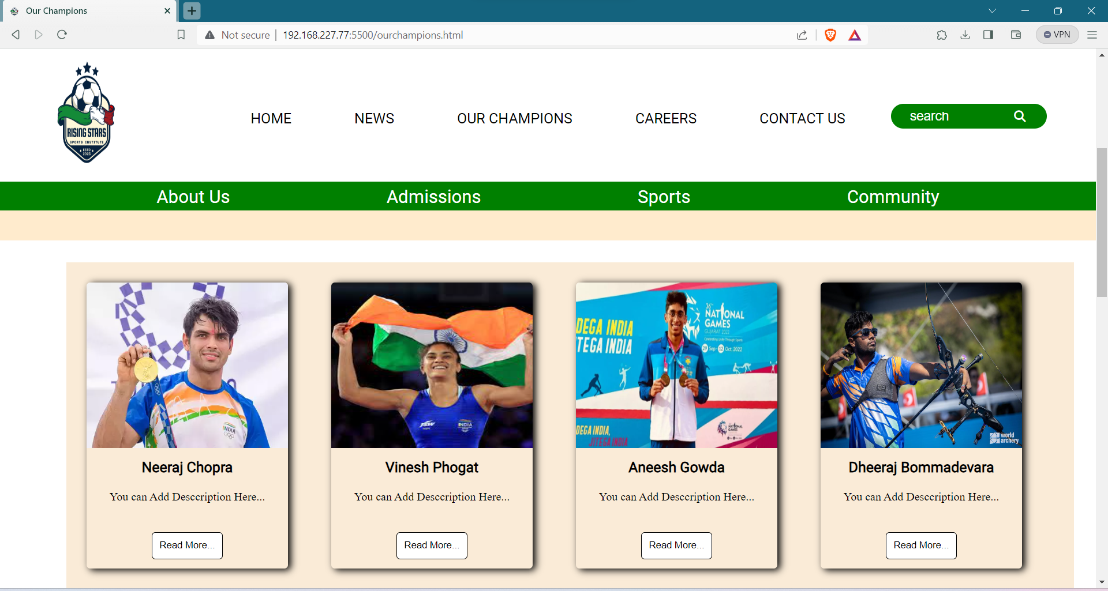
Our champions

Slide 8
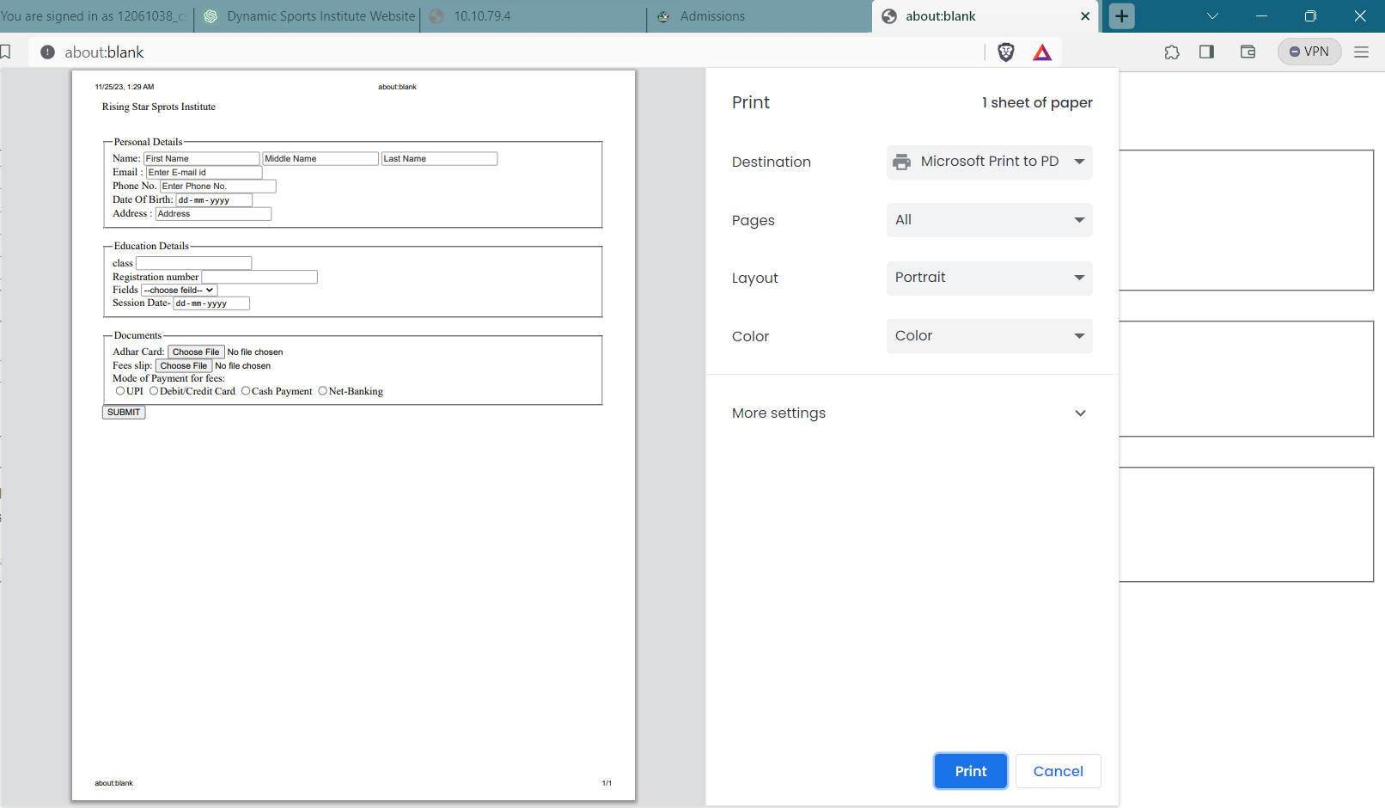
Printed receipt of Admission form
Students can use this receipt for their future references

Slide 9
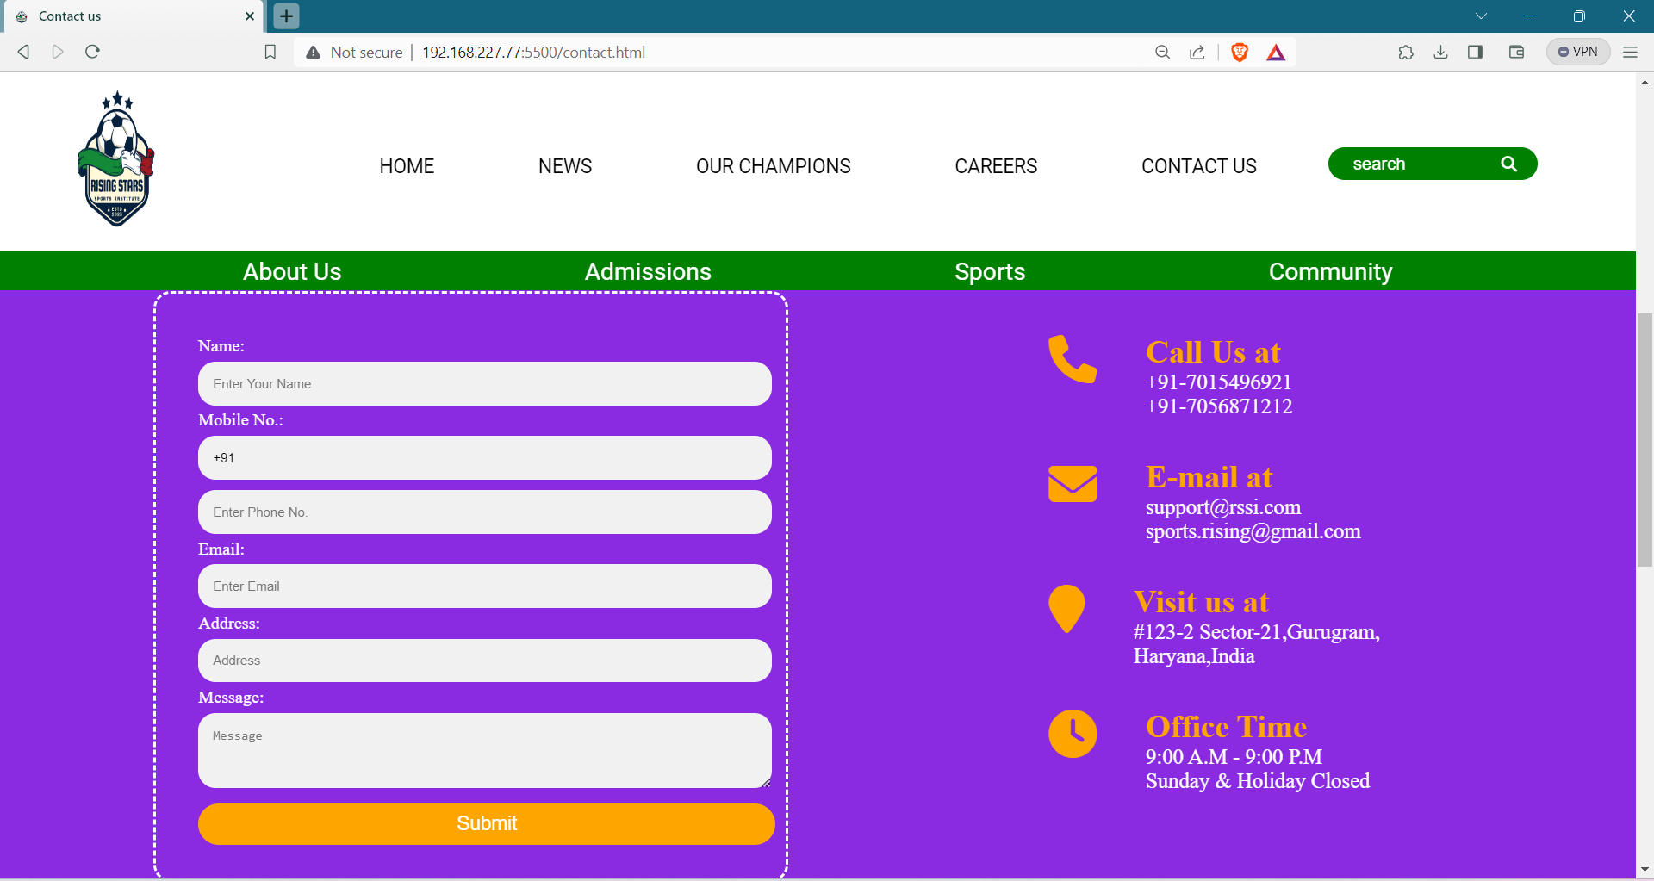
Contact page of website
This page gives information how to contact with Institute Authority

Slide 10
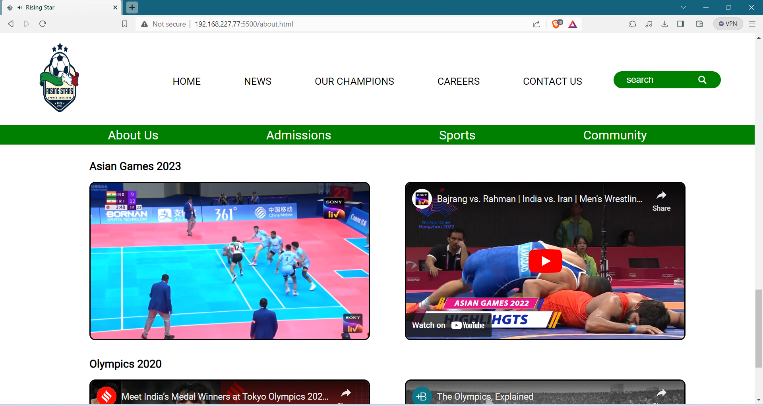
ABOUT US

Slide 11
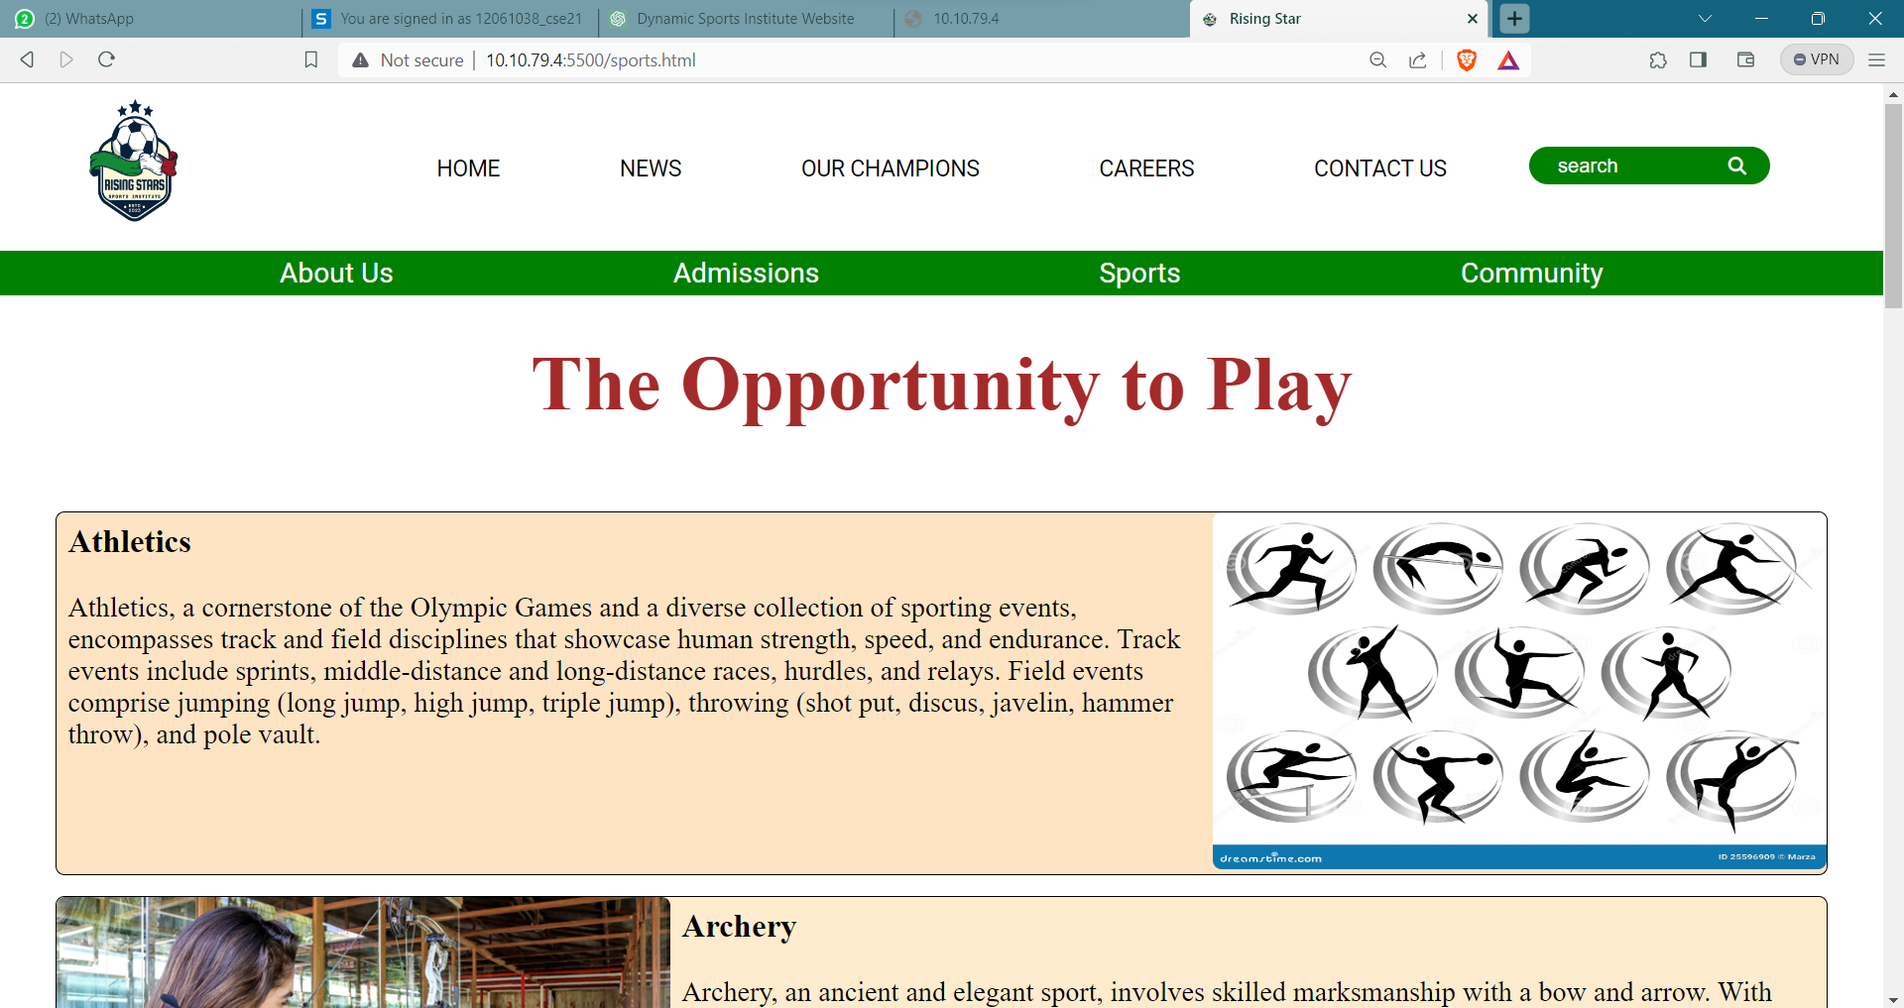
SPORTS

Slide 12
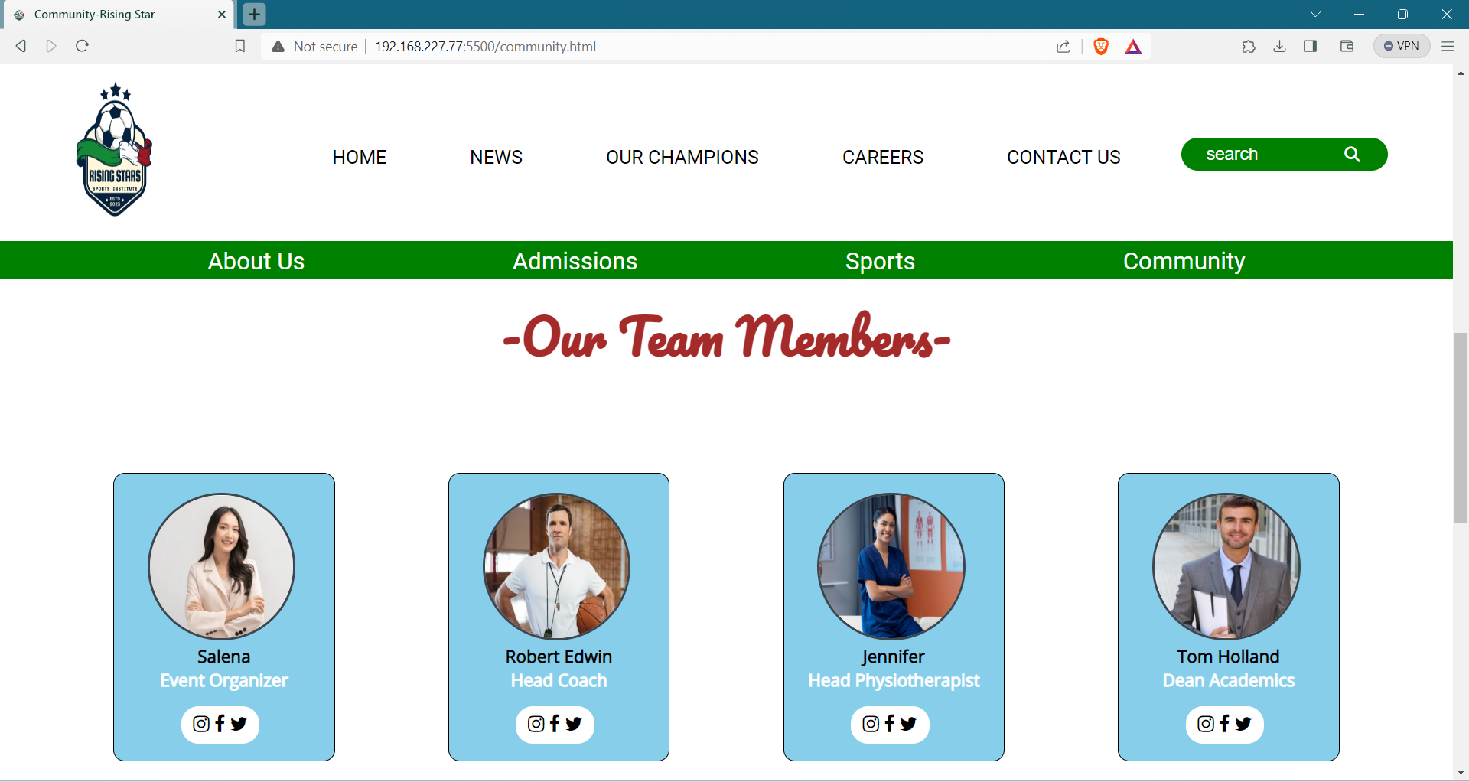
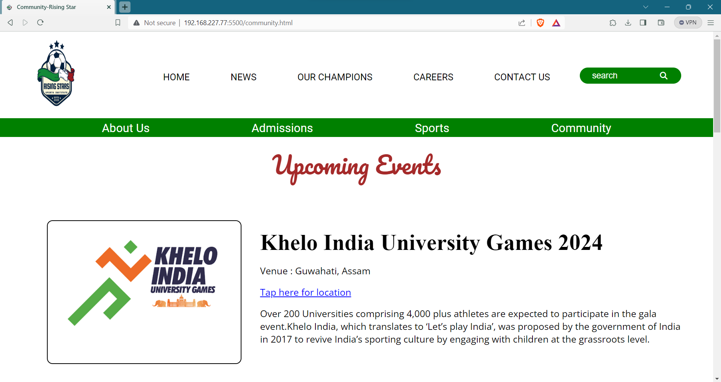
COMMUNITY

Slide 13
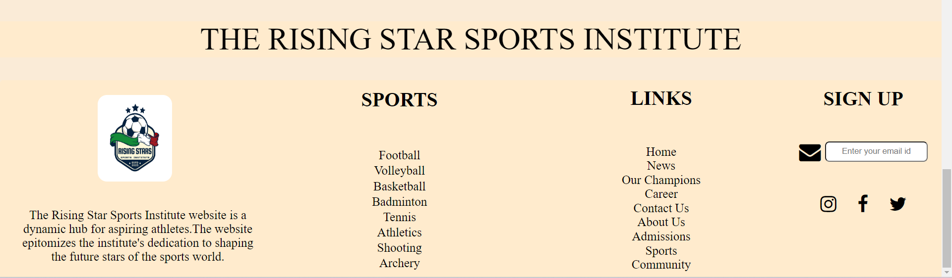
Footer
It commonly includes contact details, such as address, phone number, and email, facilitating user communication

Slide 14
conclusion
The Rising Star Sports Institute Website project has successfully achieved its objectives by employing a thoughtful combination of HTML, CSS, and JavaScript. The website is not just a digital presence but a dynamic platform that caters to the diverse needs of aspiring athletes and sports enthusiasts. The user-friendly interface and seamless navigation across key sections, including admissions, success stories, and sports programs, create an immersive online experience . The incorporation of multimedia elements, such as images and videos, enhances engagement and provides a visual representation of the institute's ethos. The News Page acts as a real-time information hub, keeping stakeholders abreast of upcoming events, workshops, and athlete achievements.

Slide 15

scope
The future scope for the sports institute involves advancing sports training services.
Advanced Interactivity: Implementing more sophisticated interactive features using evolving technologies to enhance user engagement and create a more immersive experience.
Personalized User Portals: Developing personalized portals for athletes, coaches, and parents, providing tailored content, progress tracking, and communication channels
E-Learning Modules: Integrating e-learning modules for athletes to access training materials, educational content, and skill development resources.
Integration with Wearable Technology: Incorporating compatibility with wearable technology to monitor and track athletes' performance, health metrics, and training progress.
Expanded Multimedia Content: Continuously enriching the multimedia content, including 360-degree virtual tours of facilities, live-streamed events, and high-quality promotional videos, to provide a more visually compelling and informative experience.

Slide 16
Reference
Websites:
1.w3school - https://www.w3schools.com/
2.Apollo Hospital – https://www.sportskeeda.com/
3.JavaScript.info - https://javascript.info/
Importance: JavaScript.info is a comprehensive guide to JavaScript. It covers the language basics, DOM manipulation, and advanced concepts.
Online Sources:
Websites like Udemy, Coursera, and freeCodeCamp offer courses on web development, including HTML, CSS, and JavaScript.
Importance: These platforms provide structured learning and can support your understanding of the technologies used in the project.
Magazine and News Articles
Articles from reputable sports pages magazines or news outlets.

Slide 17


THANK YOU

